Slide 1

Working with Web APIs in R
FALL 2025
Turning Online Services into Data
João Oliveira
DATA 607 – Data Acquisition and Management
Notes:
Hi everyone, my name is João Oliveira, and this is my Data Science in Context presentation for DATA 607.
Today I’m going to talk about working with Web APIs in R, and how APIs allow data scientists to turn online services into usable datasets.
A lot of the most interesting data we work with today doesn’t come in CSV files anymore. Instead, it lives behind web services, and APIs are the main way we access that data in a reproducible and automated way.
In the next few minutes, I’ll briefly explain why APIs matter for data scientists, show a small R example, and then connect this to a real business use case.”

Slide 2
DATA 607
Web APIs in R
Why Web APIs Matter for Data Scientists
Many modern data sources are only accessible via APIs
APIs allow automated, repeatable data collection
They support real-time dashboards and reporting
Core skill for data acquisition and data engineering
Notes:
Web APIs are important because many modern data sources are only available through them.
For example, marketing teams pull ad performance data from APIs, finance teams pull market data from APIs, and software teams monitor issues and usage metrics through APIs.
From a data science perspective, APIs are powerful because they allow automated and repeatable data collection. Instead of manually downloading files, we can schedule scripts that pull fresh data every day or every hour.
This fits directly into the goals of this course, which focuses heavily on data acquisition, data preparation, and building systems that reliably move data from a source into an analysis-ready format.

Slide 3
DATA 607
Web APIs in R
What Is a Web API?
A web endpoint (URL) that returns data on request
Data is usually returned in JSON format
You send a request and receive a structured response
Often includes parameters and authentication
Notes:
At a practical level, a web API is simply a URL that returns data when you send it a request.
You send a request, usually over HTTP, and you receive a response, most often in JSON format.
That JSON response is structured data that we can parse and turn into a data frame in R.
Some APIs are public, while others require authentication using an API key, but the basic idea is always the same: the API defines a contract for how data can be requested and returned.

Slide 4
DATA 607
Web APIs in R
Example: Calling a Web API with R
Use the httr package to send HTTP requests
Parse JSON responses using jsonlite
Convert API responses into tidy data frames
Clean and select useful variables for analysis
Notes:
Here’s a small example using R to call a public API.
In this case, I’m using the GitHub API to retrieve issues from the ggplot2 repository.
First, I use the httr package to send a GET request to the API endpoint. After making the request, I check the status code to confirm that the call was successful.
Next, I extract the content of the response as text and use the jsonlite package to parse the JSON into an R object.
From there, I convert the result into a tibble and select just a few useful variables, such as the issue number, title, status, the user who opened the issue, and the creation date.
At this point, the API data looks just like any other tidy dataset in R, and we can immediately analyze it, summarize it, or visualize it.

Slide 5
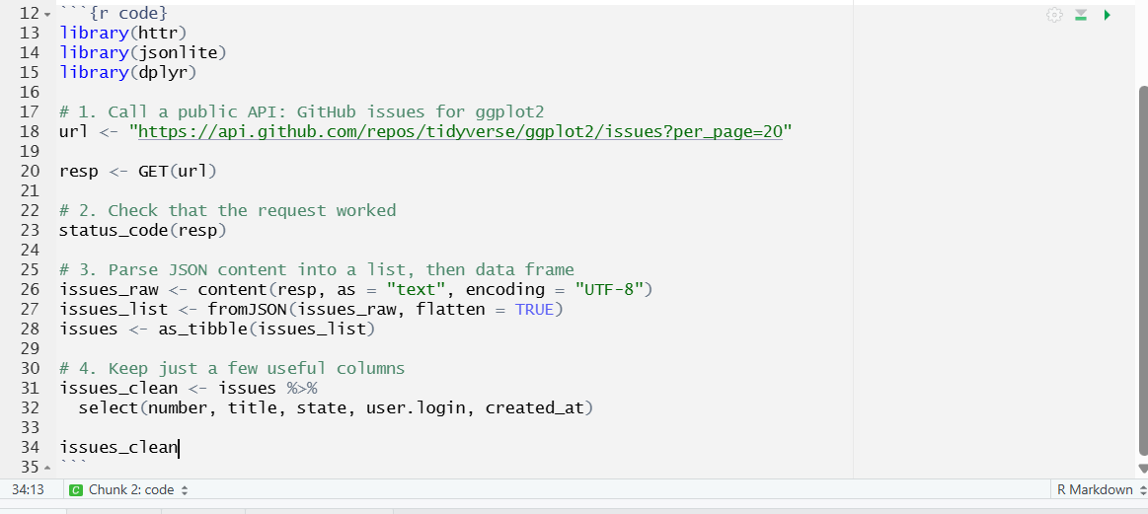
DATA 607
Web APIs in R
Example: Calling a Web API with R
Link to code: https://rpubs.com/JDO/1380807

Slide 6
DATA 607
Web APIs in R
Business Use Case
Monitor software issues or customer feedback in real time
Track operational metrics from external systems
Automate daily or weekly reporting pipelines
Integrate API data with internal databases
Notes:
In a business or organizational context, this kind of workflow is extremely common.
For example, a software team might use this data to track open versus closed issues, identify recurring bugs, or monitor response times.
More broadly, APIs make it possible to build automated data pipelines, where data is collected on a regular schedule, cleaned, and then pushed into dashboards or reports.
This is a key part of modern data engineering and supports data-driven decision making across many domains.

Slide 7
DATA 607
Web APIs in R
Learning Path & Key Takeaways
Practice with public APIs (GitHub, city open data, weather)
Learn to read API documentation carefully
APIs are essential for modern data pipelines
R makes it easy to go from web data to analysis-ready data
Notes:
For anyone who wants to learn more about working with APIs in R, a good starting point is the httr quickstart vignette and the web data chapters in R for Data Science.
Practicing with public APIs, like GitHub or city open data portals, is a great way to build confidence.
Overall, web APIs are a foundational skill for data scientists. They allow us to move beyond static files and work with live, real-world data in a reproducible and scalable way.
Thank you for listening.

Slide 8

Thank you!
DATA 607
Web APIs with R

